Slide 1
TOWER OF HANOI

Slide 2
INTRODUCTION OF TOWER OF HANOI
The tower of Hanoi ( also called the tower of Brahma or the Lucas tower) is a mathematical game or a puzzle.
Invented by the French Mathematician Edouard Lucas and sold as a toy in 1883.
It consists of three rods and a numbers of disks of different sizes which can slide onto any rod.

Slide 3
HISTORY
There is a history about an Indian temple in kashi vishwanath, which contains a large room with three time-worn posts in it surrounded by 64 golden disks. Priests, acting out the command of an ancient prophecy, have been moving these disks, in accordance with the immutable rules of the Brahma, since that time.
According to the legend, when the last move of the puzzle will be completed, the world will end.
The number of moves required to correctly move a tower of 64 disks is
2^64 -1 = 18, 446, 744, 073, 709, 551, 615.
At rate of one move per second, that is 584, 942, 417, 335 years.

Slide 4
Rules of Tower of Hanoi
Only one disk can be moved at a time.
Only the uppermost disk can be moved from one stack to the top of another stack or to an empty rod.
Larger disks cannot be placed on top of smaller disks.

Slide 5
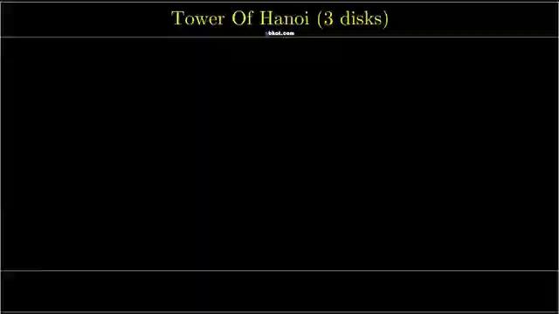

Slide 6
What are the minimum moves to solve the Tower of Hanoi problem?
The minimum moves required is 2^N – 1 to move all disks from Source rod A to destination rod B while following the rules.

Slide 7
The steps to follow are
Step 1 − Move n-1 disks from source to aux
Step 2 − Move nth disk from source to dest
Step 3 − Move n-1 disks from aux to dest

Slide 8
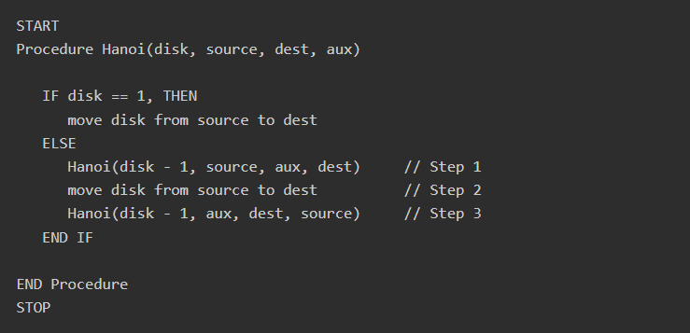
A recursive algorithm for Tower of Hanoi can be driven as follows −

Slide 9
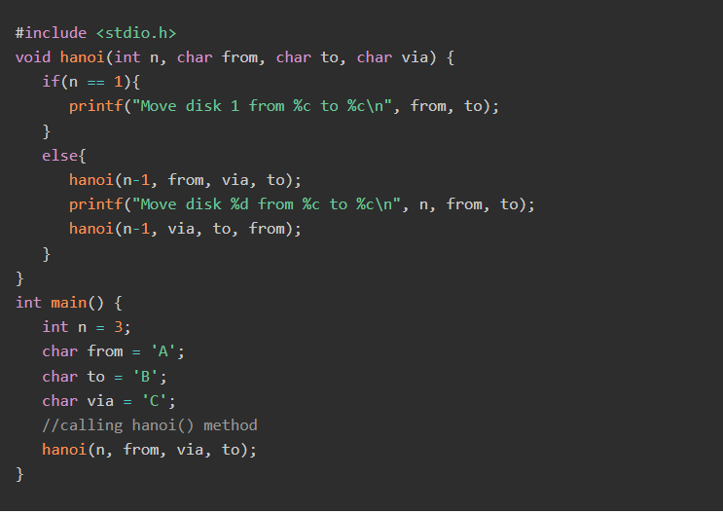
Example

Slide 10
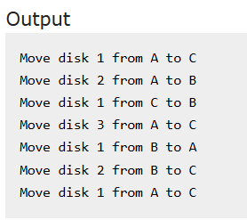

Slide 11
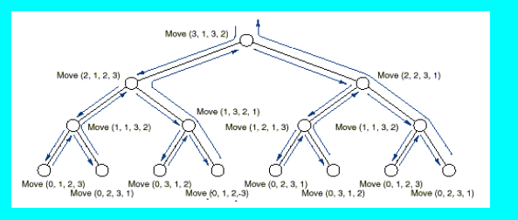
RECURSION TREE

Slide 12
THANK YOU

